Slide 1
CS193P Final Project
Aashna Garg
(Design contributions by:
Chuck Allen, Brandon Hightower)

Slide 2

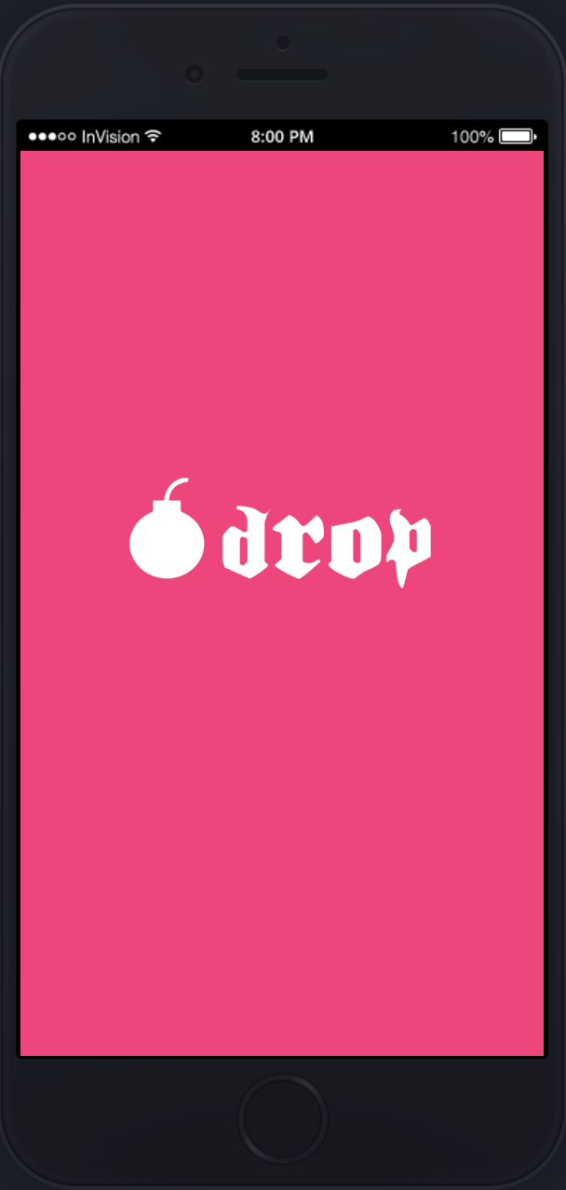
Drop
Localized Music Application

Slide 3
Enter a music zone
Zone music playlist loads instantly
And you get going!

Slide 4
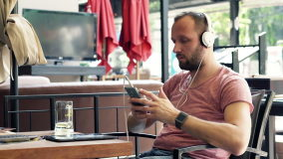
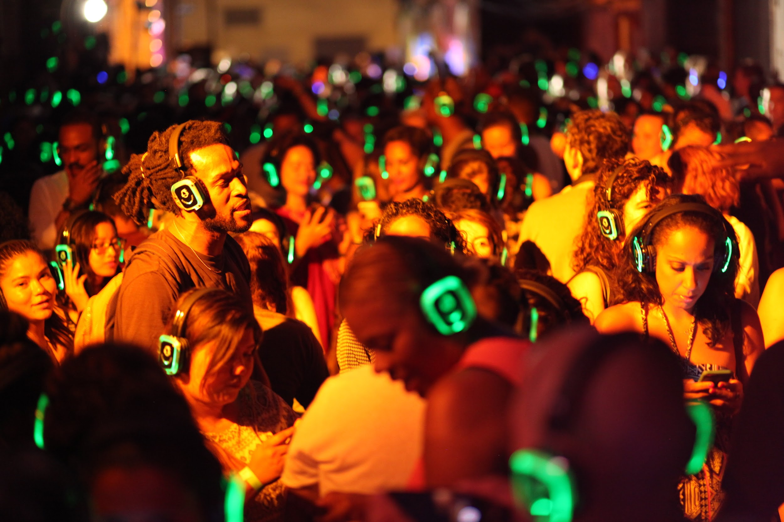
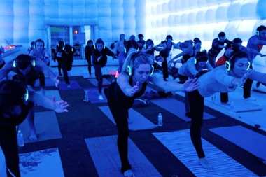
Where to use?
In your favourite cafe
Silent Disco
While working out!

Slide 5
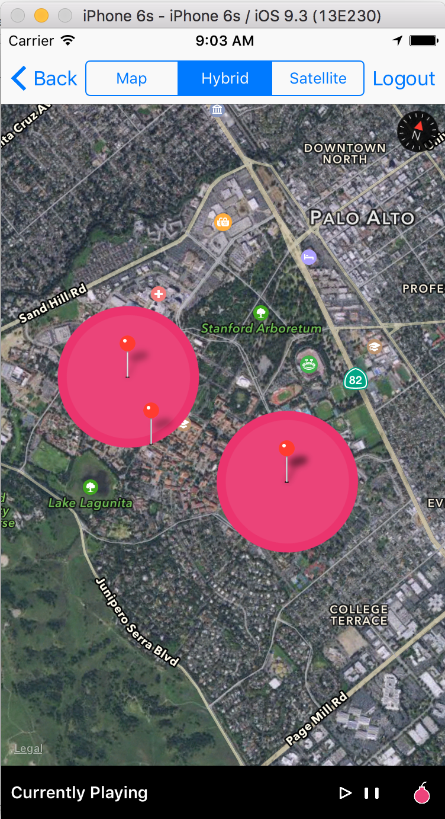
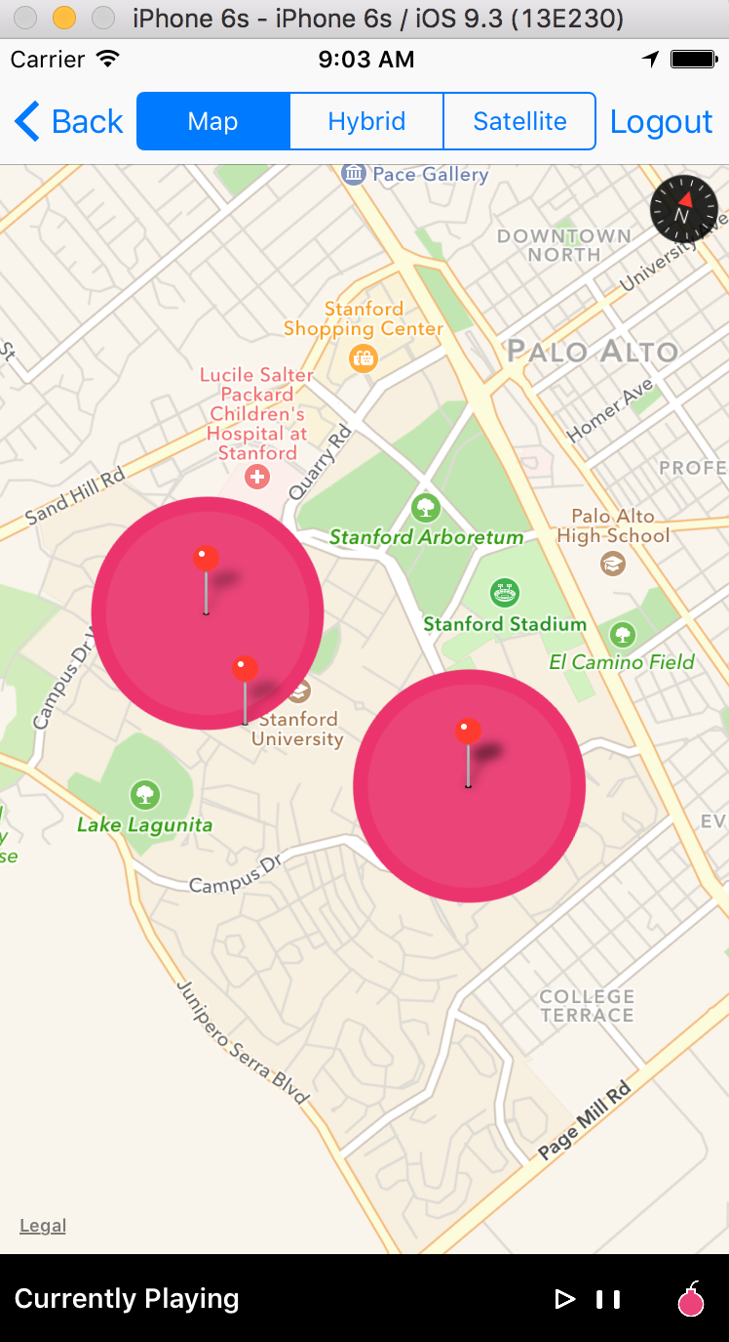
Music Zones
Once the user logs in or signs up, he can see zones on a map
These zones represent areas where there is music streaming

Slide 6
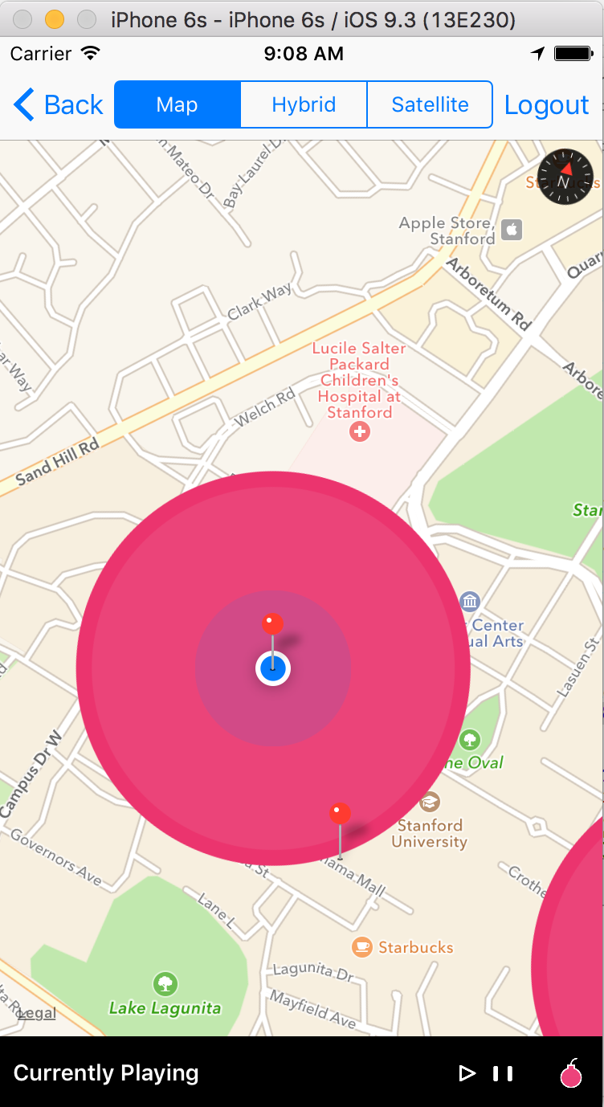
Entering a zone
When a user enters a zone (CS Gates Building, Stanford, here), he gets a notification that he has entered the zone of that music station

Slide 7
Location based music playlist
As the user enters a zone, the music playlist, from SoundCloud, specific to that location gets loaded
From here, the user can play/pause/mark favourite any song
Similarly, on entering a different zone, a different music playlist attached to that zone gets loaded up

Slide 8
Interactive Login Screen
New users can Sign Up to Drop
Registered users can simply log in
If the user forgot his password, he can click on forgot password and reset his password

Slide 9
User Sign Up
Minimal Signup details needed:
User is required to fill mandatory personal details
User Friendly date picker
User can personalize by uploading his/her image

Slide 10
Share on Facebook/
Twitter
The user also has the ability to brag about the app on social media like Twitter/Facebook/Email, etc.

Slide 11
Add Friends
See who all from your contacts are using this app
Check those whom you want to add as friends on the app
Delete/ Reorder your list of friends

Slide 12
Checkout your profile
See your profile anytime by this smart pop up on the main screen
This fetches all your account details from the backend database

Slide 13
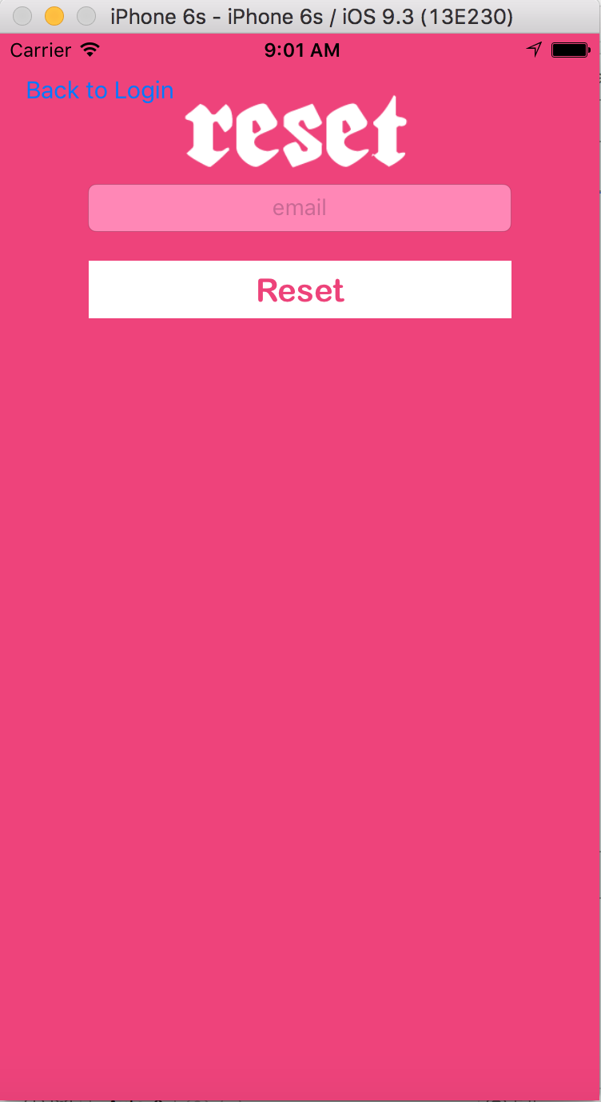
User password reset
User can reset his password here
User enters his email, when he clicks reset button, he gets a reset email on his email id that he entered

Slide 14
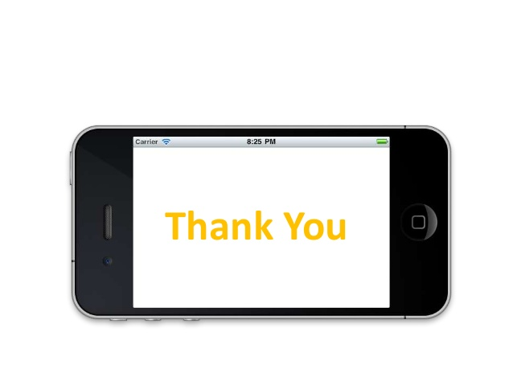
Start using Drop

